Slide 1

Branch - CSE Python Programming
Lecture – 16 Lists – Part 1
By
Dr. Smita Tiwari
Assistant Professor
Department of Computer Science and Engineering
School of Engineering & Technology

Slide 2
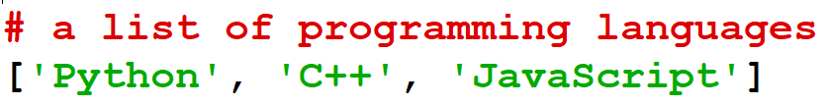
Lists in Python
Python lists are one of the most versatile data types that allow us to work with multiple elements at once.
For example,

Slide 3
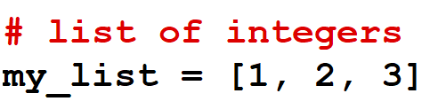
Create Python Lists
In Python, a list is created by placing elements inside square brackets [ ], separated by commas.

Slide 4
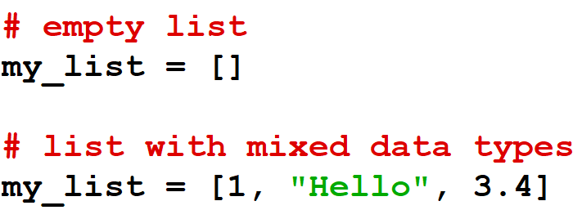
Create Python Lists
A list can have any number of items and they may be of different types (integer, float, string, etc.).

Slide 5
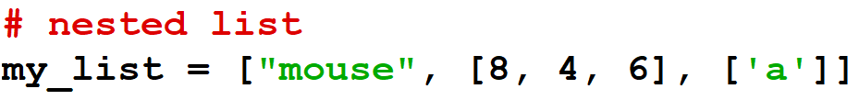
Create Python Lists
A list can also have another list as an item.
This is called a nested list.

Slide 6
Access List Elements
List Index
We can use the index operator [] to access an item in a list. In Python, indices start at 0. So, a list having 5 elements will have an index from 0 to 4.
Trying to access indexes other than these will raise an IndexError. The index must be an integer. We can't use float or other types; this will result in TypeError.
Nested lists are accessed using nested indexing.

Slide 7
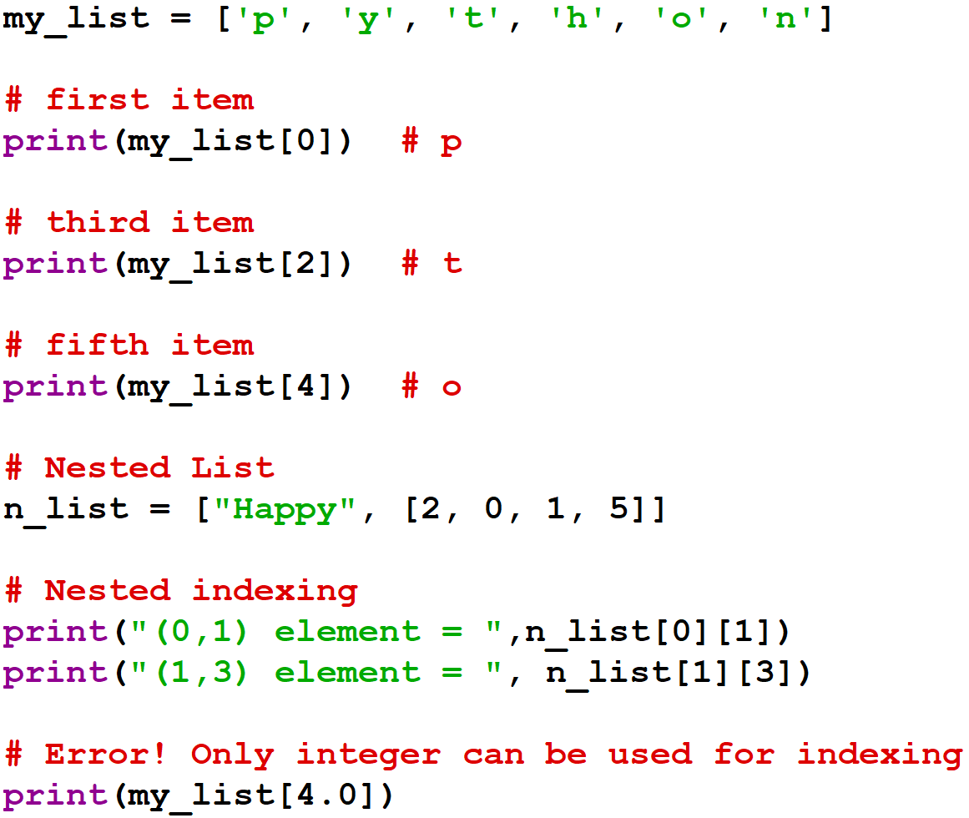
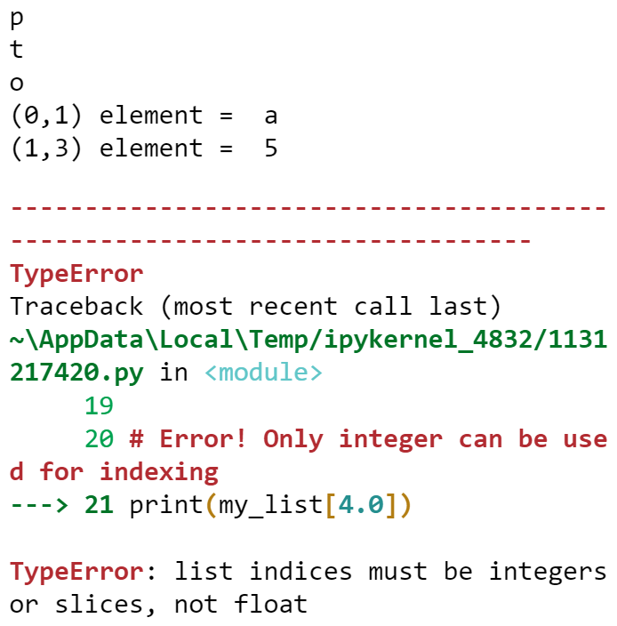

Slide 8
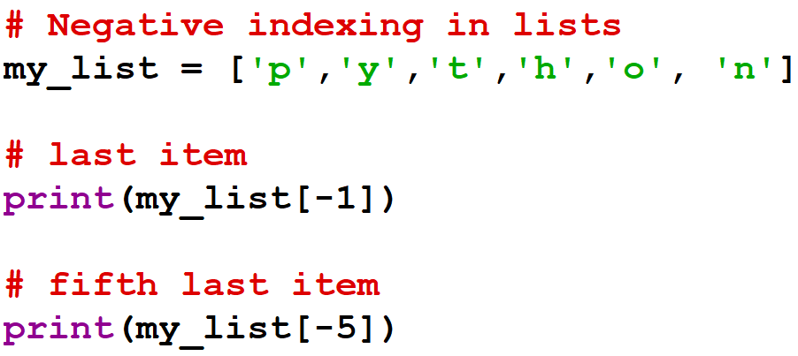
Access List Elements
Negative Indexing
Python allows negative indexing for its sequences. The index of -1 refers to the last item, -2 to the second last item and so on.
Output:
n
y

Slide 9
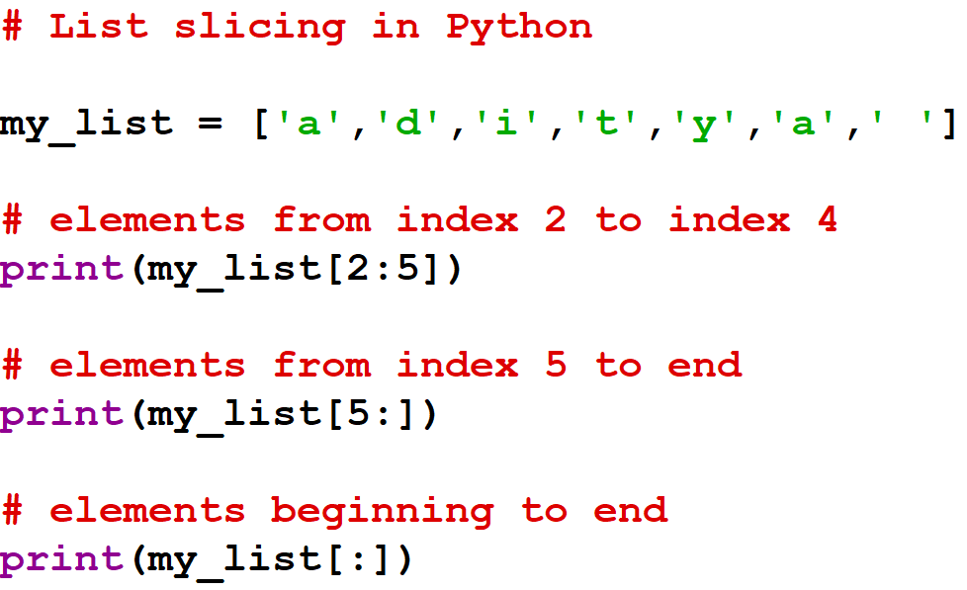
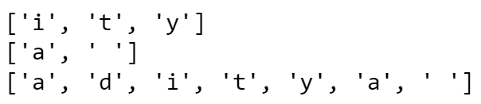
List Slicing in Python
We can access a range of items in a list by using the slicing operator ‘:’.
Output:

Slide 10
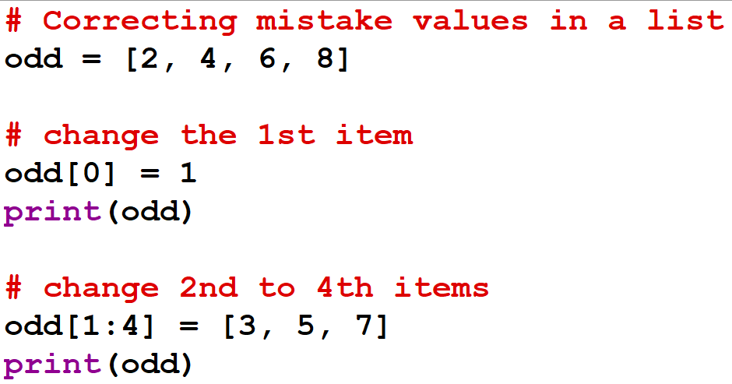

Add / Change List Elements
Lists are mutable – their elements can be changed unlike string or tuple.
We can use the assignment operator ‘=‘ to change an item or a range of items.
Output:

Slide 11
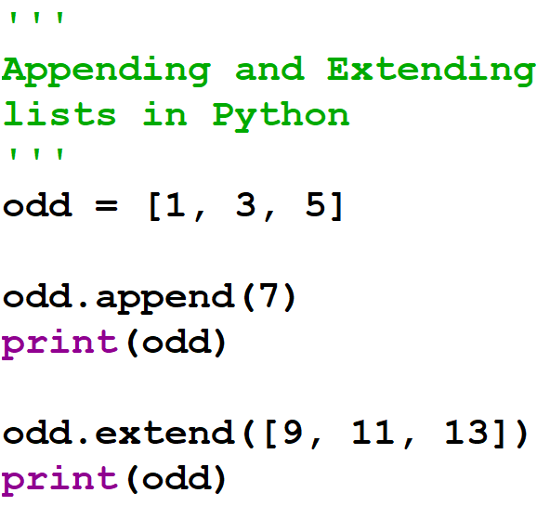

Add / Change List Elements
We can add one item to a list using the append() method or add several items using the extend() method.
Output:

Slide 12
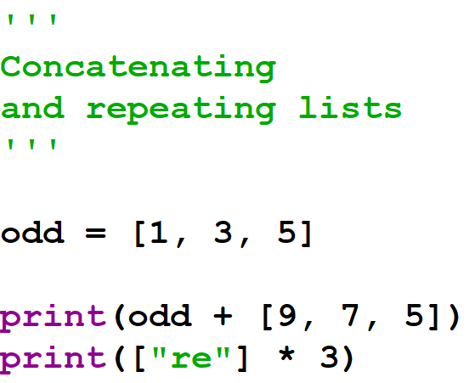

Add / Change List Elements
We can also use + operator to combine two lists. This is also called concatenation.
The * operator repeats a list for the given no. of times.
Output:

Slide 13
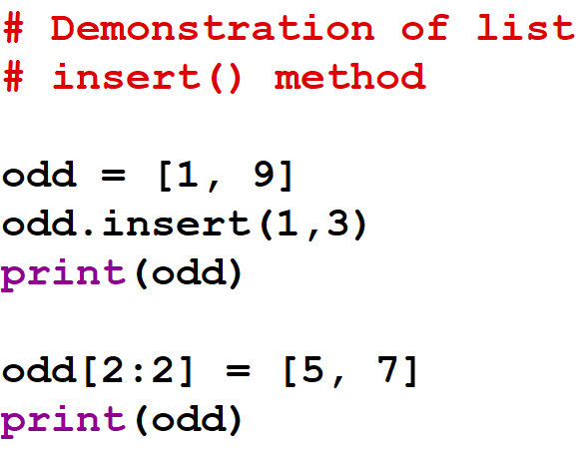
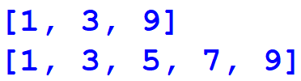
Add / Change List Elements
Furthermore, we can insert one item at a desired location by using the method insert() or insert multiple items by squeezing it into an empty slice of a list.
Output:

Slide 14
THANK YOU

